Slide 1
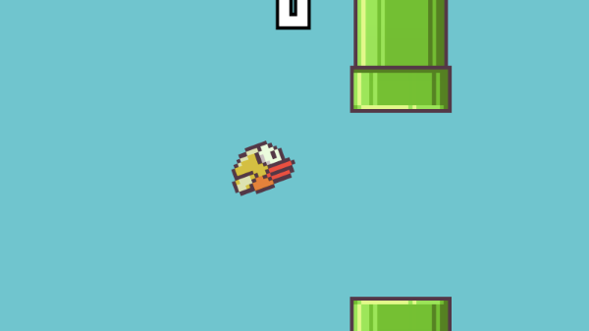
Capstone Project: Train an AI Agent to Play Flappy Bird
By: Jesus Gudino
ITAI 1378
04/01/2025
Professor: Anna Devarakonda

Slide 2
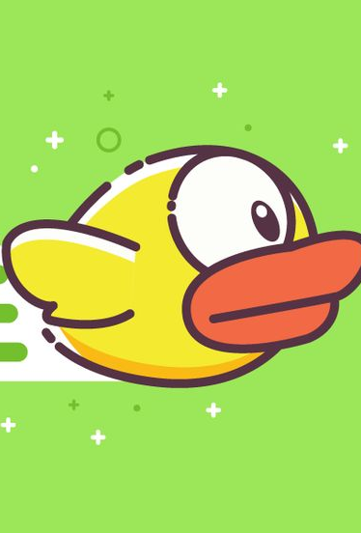
Environment Setup
Flappy Bird Game Overview:
- 2D side-scrolling game where a bird avoids pipes.
- Gravity pulls the bird down; flapping makes it rise.
- Score increases by 1 for every pipe passed.
- Game ends if the bird hits a pipe or the ground.
Tools & Libraries:
- PyGame: Simulates game environment and visuals.
- OpenAI Gym: Structures the game for reinforcement learning.
AI Interaction Setup:
- State: Bird’s position, velocity, distance to pipes.
- Actions: 0 = Do nothing, 1 = Flap.
- Rewards: +1 for passing a pipe, 0 or -1 for crashing.
Preprocessing Game Frames:
- Convert to grayscale, resize (e.g., 84×84).
- Normalize pixel values.
- (Optional) Stack frames for motion awareness.

Slide 3
Pre-Training Model Usage
Transfer Learning:
- Reuses knowledge from a model trained on a large dataset.
- Speeds up training and requires less data.
Chosen Model: MobileNetV2
- Lightweight and efficient.
- Ideal for extracting features from visual inputs.
Model Modification:
- Remove top classification layers.
- Use output from intermediate layers as features.
- Feed extracted features into the reinforcement learning agent.
Challenges & Solutions:
- Game frames differ from real-world images.
- Solution: Preprocess frames (grayscale, resize).
- Fine-tune model if needed to better suit game visuals.

Slide 4
Reinforcement Learning implementation
Basics of Reinforcement Learning:
- Agent learns by interacting with the environment.
- Key concepts: States, Actions, Rewards, Policies.
Chosen Algorithm: Deep Q-Network (DQN)
- Learns Q-values for state-action pairs.
- Selects actions that maximize expected rewards.
Required Components:
- Q-network: Maps state input to Q-values.
- Replay Memory: Stores past experiences for training.
- Target Network: Stabilizes learning with delayed updates.
Exploration vs Exploitation:
- Use epsilon-greedy strategy.
- Start with high exploration (random actions), reduce over time.
Experience Replay:
- Randomly samples past experiences.
- Breaks correlation between events.
- Improves learning efficiency and stability.

Slide 5
Model Training
Training Process:
- AI observes the state and selects an action.
- Receives a reward and the next state.
- Stores the experience in replay memory.
- Trains the Q-network using sampled experiences.
Training Loop Setup:
- Loop through episodes.
- At each step: choose action → update state → store experience → train.
Hyperparameters:
- Learning rate, discount factor (gamma), batch size, epsilon decay.
- Tune using grid search or trial-and-error.
Training Challenges:
- Reward sparsity: provide small rewards for staying alive.
- Catastrophic forgetting: use experience replay + target network.
Model Evaluation:
- Track average score and loss per episode.
- Plot performance trends over time.

Slide 6
Testing and Evaluation
Testing Strategy:
- Run the trained agent across multiple game episodes.
- Use consistent starting conditions for fair evaluation.
Evaluation Metrics:
- Average score per episode.
- Survival time (duration before crashing).
- Number of pipes passed.
Interpreting Results:
- Compare agent performance against random baseline or human score.
- Look for consistent improvement across episodes.
Performance Visualization:
- Plot rewards and scores over time.
- Use heatmaps or decision maps to show AI’s choices.
Future Improvements:
- Experiment with different RL algorithms (e.g., PPO, A2C).
- Fine-tune reward system or input features.
- Add more complex obstacles or dynamic challenges.

Slide 7
Works Cited:
Sutton, R. S., & Barto, A. G. (2018). Reinforcement Learning: An Introduction (2nd ed.). MIT Press.
Sandler, M., Howard, A., Zhu, M., Zhmoginov, A., & Chen, L. C. (2018). MobileNetV2: Inverted Residuals and Linear Bottlenecks. arXiv preprint arXiv:1801.04381.
Brockman, G., Cheung, V., Pettersson, L., Schneider, J., Schulman, J., Tang, J., & Zaremba, W. (2016). OpenAI Gym. arXiv preprint arXiv:1606.01540.
Flappy Bird Reinforcement Learning Environment: https://github.com/ntasfi/PyGame-Learning-Environment
TensorFlow & Keras Documentation: https://www.tensorflow.org/
PyGame Documentation: https://www.pygame.org/docs/

